Slide 1
Alternative use of blockchain
TEAM 4

Slide 2
Introduction
Blockchain – A term so synonymous with Cryptocurrency, it is barely understood by the world at large. The buck stops at “payment system” and is never explored beyond. Today, team 4 takes you to a journey for blockchain, preparing you to see how blockchain technology can revolutionize carbon markets, supply chains, and education systems.
The concept of tokenization, verification, data integrity, smart contracts etc to name a few, the potential here being that no field can now resist the efficiency of block chain. The question is no more “Can we include this in Blockchain” but “How do include this in Blockchain”

Slide 3

The journey so far
Finance has come a long way, from the age of ink-stained ledgers maintained by quills, to modern blockchain technology. Traditional and even modern electronic ledger have proven themselves to be vulnerable to fraud, human error, inefficiency and slower speeds. As is with all revolutions, we now enter a phase of large scale blockchain usage, with centralized databases, ever evolving security and a never-before seen efficiency. This shift in not merely an upgrade to a software, but an entire transformation of the global financial systems.

Slide 4
Traditional finance vs blockchain
In traditional finance, your money goes on a secret adventure. In blockchain, it leaves a trail like Hansel and Gretel—only with fewer breadcrumbs and more code.............and no witch at the end.
An overview of inefficiencies of traditional finance and how blockchain overcomes and takes an adaptive evolved step rather than just mitigation.
"Decentralized Finance (DeFi)" by Mansur Bestas (2023)

Slide 5




Key Issues In traditional Finance
Fraud
Inefficiency
Cost savings
Slower verification
Traditional finance often uses data silos prone to manipulation and opacity (Enron Accounting Scandal).
Traditional Finance, and its centralised databases controlled by single entity are vulnerable to hacks and fraud ($81M Bangladesh Bank heist).
Traditional finance may have high fees due to brokers, banks & custodians. Manual processes slow down transactions and increase costs.
SWIFT transfers may take days, whereas blockchain transfers take seconds/minutes.

Slide 6
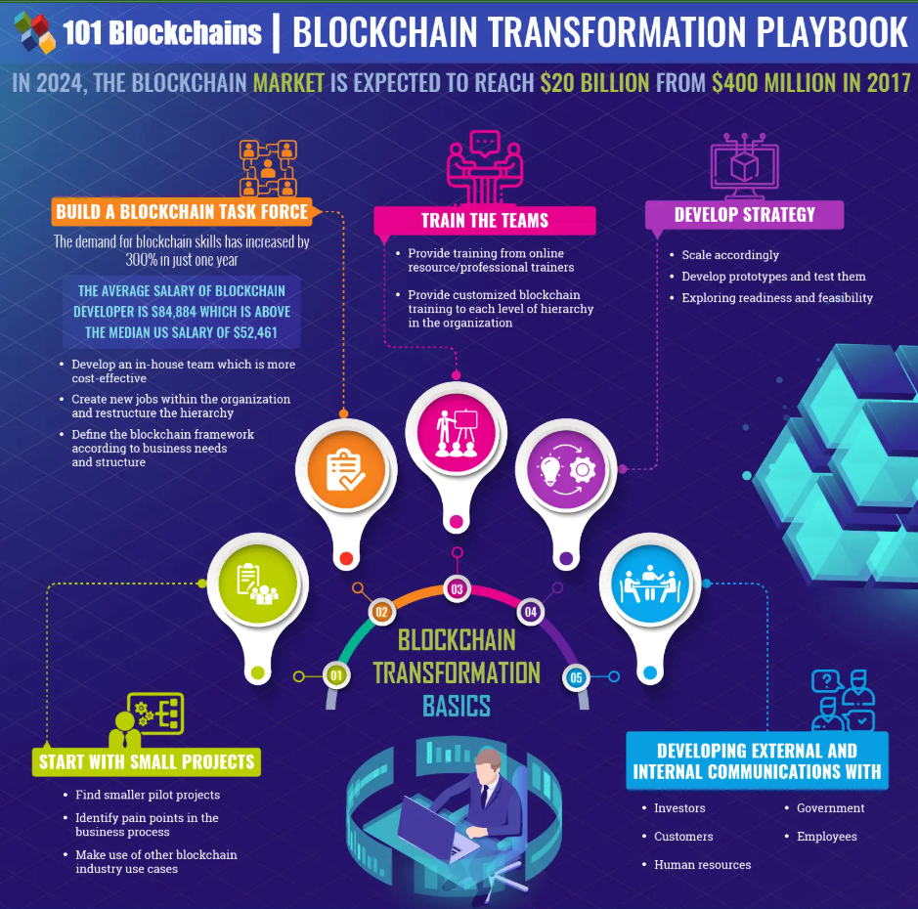



How Blockchain fixes Problems
Transparent & Data Integrity
Security & Fraud Prevention
The Blockchain’s public/permissioned ledger counter this by being immutable and show real-time visibility enhancing history trust.
Blockchain networks being decentralized with multiple nodes and cryptographic security prevents such attacks.
Cost structure & Intermediary
Transaction speed & Efficiency
Blockchain reduces intermediaries, cut costs for transaction. Peer-to-peer costs pennies, In 2022, a $1 billion transaction on the Bitcoin network had a fee of only $0.68, showcasing blockchain’s cost efficiency.
Blockchain’s smart contracts, automating verification & settlement may only take seconds or minutes with
Oracles bringing real-world data to blockchain.
From weeks to seconds, from opacity to transparency—Blockchain transforms the status quo – Blockchain.com

Slide 7
BitGive uses blockchain to show donors exactly how funds are used, offering transparency in charitable donations.
Secure patient data system. Medi-Ledger ensures transparent pharmaceutical supply chains.
Blockchain Beyond Payments
Healthcare
Real-Estate
Voting system
Art & Digital NFT
Charity and donation
Academic Reference "Blockchain Technology: Beyond Bitcoin" by Melanie Swan (2015)
Propy uses blockchain for transparent and efficient real estate sales, enabling smart contracts and tokenized property deals.
Voatz utilizes blockchain technology to allow secure mobile voting for overseas citizens and military personnel.

Slide 8

AirCarbon Exchange
“Carbon credits are like the calories of the corporate world—everyone’s trading them, but nobody’s sure where they go”
An overview of our first case study - AirCarbon Exchange - transforming the traditional carbon market by tokenizing carbon credits

Slide 9
AirCarbon Exchange – ACX – PROCESS
Carbon Credit creation Accredited environmental projects generate carbon credits by reducing carbon emissions.
Verified by third party e.g., Gold Standard, Verra
Tokenization of Carbon credits Once verified, the credits are converted into digital tokens on ACX.
The tokenization process involves minting ERC-20 through smart contracts, with one ton of C02 reduction = 1 token
Listing on ACX Trading platform The platform functions like a stock exchange, offering real-time order books, market depth analysis, and trading pairs.
Sellers can list their tokens, setting prices and conditions, while buyers can place bids
Trading and settlement When a buy order matches a sell order, a smart contract executes the transaction automatically. The entire transaction is recorded on blockchain, ensuring traceability.
Redemption & Utilization The buyer can hold the token as an investment or redeem it, wherein the token is burned, ensuring no double count. The market credit is then no longer traceable ensuing integrity.
Report & Compliance Automatic compliance reports showing history, transaction & reports, ready to be shared with regulators and the like.

Slide 10
Aircarbon Exchange – unique features
Decentralized ledger
Smart contracts
Security, transparency, preventing fraud and data tampering. Automated settlements and compliance.
Permissioned Blockchain
Community voting on policies
Governance model , only authorized entities can mint and validate tokens integrated with community voting.
KYC/AML Checks & Reporting
Oracle Integration
Regulatory compliance, smart contracts ensure compliance. Oracle Keeps blockchain data aligned with real-world emissions data.
Access. Seamless transition for all participants.
Open marketplace
“Trading Carbon Credits on blockchain” : Erasmus University, 2024

Slide 11

Aircarbon Exchange VS TRADITIONAL MARKETS Traditional finance is like balancing on a seesaw—slow, heavy, and always leaning to one side. Blockchain? It's the jetpack that makes you forget the seesaw ever existed.
Traditional Carbon Mkt
High fees and restricted with brokers and intermediaries
Manual process, Opaque Ledger
ACX
Low fees, peer-to-peer trading
Full visibility with decentralized ledger
Settlement near instant with smart contracts
Open to all

Slide 12
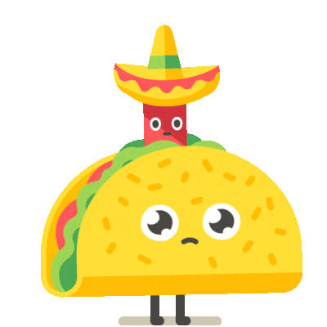
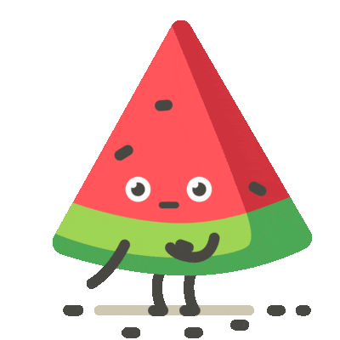
IBM Food Trust
“If traditional supply chains are the ‘Where’s Waldo?’ of food safety, then IBM Food Trust is like finding Waldo with a GPS”
An overview of our second case study – IBM Food Trust - a blockchain-based supply chain solution designed to increase transparency, enhance food safety, and improve efficiency in the global food ecosystem.

Slide 13
IBM FOOD TRUST – PROCESS
Data Onboarding Produces, suppliers & distributors upload product data, origin, processing method & certifications.
Tokenization of Information Each batch is assigned a unique digital token which carries metadata about products journey.
Blockchain tracking The product moves through the supply chain, with each touchpoint having its own updates preventing data manipulation.
Smart Contract Smart contracts ensure payments are processed only when predefined conditions are met. A retailer’s payment is released to the distributor only when products are delivered, with data verified on the blockchain.
Verification & Engagement The final consumer can scan QR codes, to view the entire history of product, with compliance reports on every step by every agency.

Slide 14
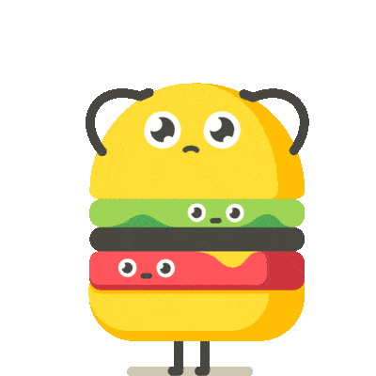
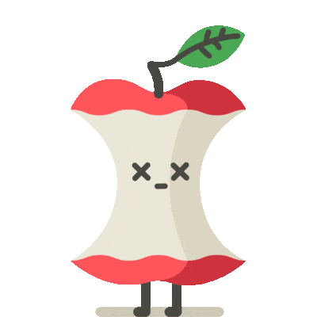
IBM FOOD TRUST – unique features
Storytelling Features: Brands can share stories of farmers, sourcing practices, and sustainability initiatives, enhancing consumer engagement.
Trust the food chain
Real-time scalability
Advanced analytics Insights
IoT Devices
Transparency Tool
Seamless Integration
Instant access to product history. E. coli outbreak, Walmart used IBM Food Trust to trace contaminated lettuce to its source within seconds
Predictive analysis, to optimize supply chains with waste management & vulnerabilities
“Blockchain in the future of food industry based on consumer trust" : Vinay Singh and Sanjeev Sharma (2022)
IoT sensors monitor temperature, humidity, and storage conditions. Example: A sensor detects temperature fluctuations in a transport vehicle, triggering a smart contract alert

Slide 15
IBM Food trust
QR codes provide comprehensive product history
Blockchain automation, instant transactions
Traditional
Cost & Data Integrity
Manual trade In international
Smart contracts reduce manual processes

Slide 16

Protocol
Team 4 presents our brainchild, a blockchain-based protocol designed to securely issue, verify, and store academic credentials, offering transparency, security, and global scalability solution;
EduTrust Scale Where Academic Credentials Meet Global Standards

Slide 17
EduTrust SCALE: The Vision
Our vision for EduTrust Scale is to create a global standard for secure, verifiable, and universally recognized academic credentials. By leveraging blockchain technology, we aim to eliminate credential fraud, uncertainty, streamline verification. The protocol will provide scalable solutions region wise, converting the local academic credentials and suit it better to our needs.
INCLUSIVITY
Training
Transparency
Security
Instant & verifiable academic records accessible to students, institutions & employers.
Immutable records, secured on a de-centralized blockchain preventing tampering and fraud. Using a replication of SHA 256 algorithm
Offering opportunities for individuals from diverse educational backgrounds to showcase their credentials globally.​
The platform will showcase a training/demo version for students and universities as a starting platform.

Slide 18



Need for EDUTRUST Scale
Verification
Storage
Globalisation
Lifelong Learners
Emerging Tech
With he rise of diploma mills, and false student credentials, EduTrust introduces unforgeable academic credentials which goes both way.
Data may sometimes be lost due to mismanagement, or human error, EduTrust ensures lifelong, immutable access to credentials.
As students and professionals move across borders, seamless and rapid credential verification is crucial for higher education admissions and job applications.
In an era of micro-credentials, bootcamps, and online certifications, EduTrust Scale can integrate all forms of learning into a single, universally recognized ledger.
EduTrust Scale offers a decentralized, tech-forward approach. The training version will contain a EOA, externally owned account to transact and learn contracts.

Slide 19
How EduTrust Scale Works
Clients with premium access can conduct Oracle-driven analysis as to which candidate matches their needs the most.
The data will be stored on a proprietary, built-in fully fledged language. Cryptographically hashed and recorded.
Data Onboarding
Tokenization
Verification
Access & Sharing
Employer Validation
Lifelong Credentials
Blockchain’s immutability ensures that credentials cannot be altered or deleted, with automatic updates upon completion of credential.
Academic credentials are converted into digital tokens, with each token representing specific credentials and contain metadata. Tokens are then stored in digital wallet.
Employers use decentralized identifiers (DIDs) to access the blockchain.
Smart contracts automate the verification process, ensuring instant and accurate results.
Access is controlled by students, who can share their credentials with employers, institutes & stakeholders via a QR code, or link.

Slide 20
Governance and Adoption model
Governance
Decentralized Autonomous Organization
Oracle driven smart contracts completion and analysis
Stakeholder representation
Audit
Adoption
Academic Partnerships
Corporate Integration
Global Expansion
Government Collab

Slide 21
Traction
Forecasting for success​
Key metrics
 | Clients (Est) | orders | Gross avenue | Net revenue
2025 | 10​ | 5000 | $10,000​ | 0​
2026​ | 20​ | 6000 | $15,000​ | $4000
2027​ | 30​ | 8000​ | $30,000​ | $10,000​
2028​ | 50​ | >10000​ | $50,000​ | $40,000​
2029​ | 70​ | >15000​ | $70,000​ | $65,000​
2030 | 90 | >18000 | $90000 | $86,000

Slide 22
Scalability
Beta Version
Launch
One-year Progress
Premium Subscription – Beta Launch
Europe Reach out
Growth Check and adjustment.
2025 - 2028
Jan
Feb, 2025
Mar
Apr
May, 2025
Jun, 2026
Jul
Aug, 2027
Sep
Oct, 2027
Nov
Dec, 2028
International Launch
Four-Year Progress
Large Scale Integrated movement
2028-2030
Jan
Feb, 2028
Mar
Apr
May
Jun
Jul, 2029
Aug
Sep
Oct
Nov
Dec, 2030

Slide 23
Funding
12K
14K
32K
42K
University
Angel Investments
Angel Investors
Second Phase Investment
Covers 6 months of server costs.
Supports initial platform development, including premium version.
Later stage investments, for international scaling
Post-2028 Investments for continental expansion.

Slide 24
Prashanth nair​​
5669869, MSc Finance

Slide 25
Conclusion
Blockchain transforms traditional systems by addressing fraud, inefficiency, and high costs through transparency, speed, and cost efficiency. From supply chains to carbon trading and academic credentialing, blockchain’s potential is limitless. EduTrust Scale exemplifies innovation, paving the way for a secure, efficient, and inclusive future.

Slide 26
Thank you

